Slide 1
What’s the Problem?
The need to create a model to project the future of investments in Big Mountain resorts, specifically focusing on four scenarios . As well as determining if the Montana resort(target resort) is under selling ticket price.
Scenario 1: Permanently closing 10 least used runs
Scenario 2: Increasing vertical drop by adding another point, 150 ft lower, no additional snow cover
Scenario 3: Similar as Scenario 2, but with an addition of 2 acres of snow making
Scenario 4: Increase the longest run by 0.2 miles to have the longest run(3.5 miles) with 4 acres of snow making

Slide 2
Recommendations and Key Findings
There are some key features that have a direct correlation to ticket pricing(rank from most to least important): vertical drop, Snow Making_ac, total_chairs, fastQuads, Runs, LongestRun_mi, trams, and SkiableTerrain_ac
We also discovered the Montana resort is undercharging which will be later explained when discussing about the modeling results section of the Powerpoint
Scenarios 1-3 should be implemented at a slow rate to ensure that current ticket prices somewhat matches projected ticket prices.
Another alerting topic to discuss is the possible incorrect data input of Silver Mountain’s skiable area. In the provided data, the area claims to be 26,819 ft while on the ski resort’s website it shows an area of 1,819ft. Our firm proceed with the second number. This could possibly affect the overall data, but these numbers can be switched out if the provided data is correct

Slide 3
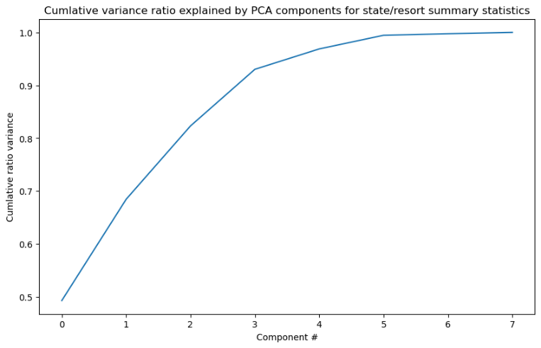
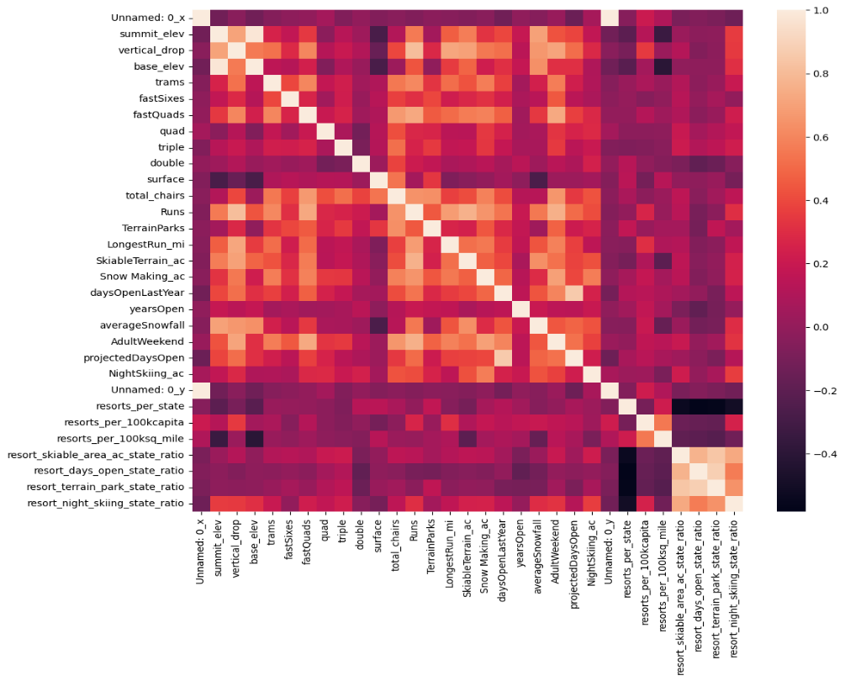
Modeling Results and Analysis
A Principal Component is to reduce the number of dimensions to allow a 2d view .This graph will demonstrate that the first two components adds up to over 75% of component variances ,therefore, to proceed with the model making, these two components should be focused to see if there is correlation between ticket pricing and these two components.
However, these two components failed to show a correlation even despite creating a scatter plot. The scatter plot did reveal that Vermont and New Hampshire have high ticket pricing despite both states being on the smaller side compared to other states. The reasoning for these two outliers are the high resort density.
Looking into these two features “resorts_per__100kcapita” and “resorts_per_100ksq_mile,” there appears to be a correlation. Causing our firm to apply a “components_” argument to analyze each features’ contribution to the cumulative ratio variance. Now all the data required for a heat map is acquired. Generating this heat map:

Slide 4
Modeling Results and Analysis
From the previous heatmap, it is seen that the most important features for high ticket priced resorts are vertical_drop, Snow Making_ac, total_chairs, fastQuads,Runs, LongestRun_mi, trams, and SkiableTerrian_ac
Now the model can be created to predict the outcome of the four scenarios with the addition of the returns of the targeted state, Montana.

Slide 5
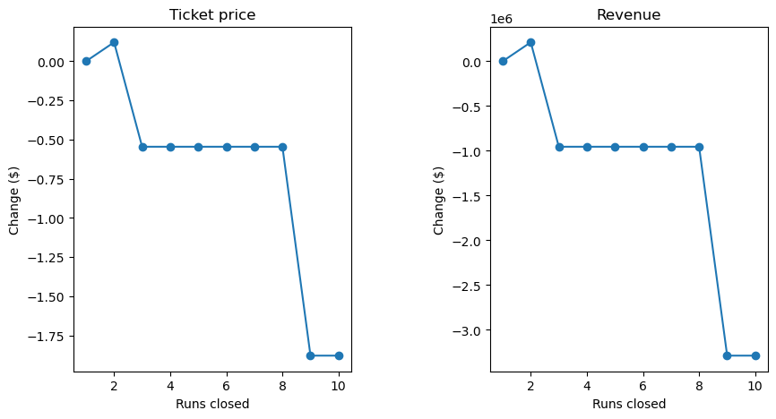
Modeling Results and Analysis
Scenario 1: The outcome projected that the closure of one to two runs will drop ticket price/revenue. Although ,after closing 3-8 runs the ticket price remains the same as seen on these graphs:

Slide 6
Modeling Results and Analysis
Scenario 2: Increased ticket price by $8.48 is expected creating a revenue of $14,848,485. To be expected considering this would increase amount of vertical drop and runs.
Scenario 3: It is not surprising that this scenario also increases revenue. However, the increase of ticket price with the additional snow making would be $9.36. Increasing the revenue, in this scenario to $16,386,364.
Scenario 4: Unlike the other scenarios the increase length of run does not predict an increase in ticket price. This mainly because longest run is not the most important feature in a ski resort

Slide 7
Summary and Conclusion
In conclusion Scenarios 1-3 should be further investigated to increase revenue while Scenario 4 can be ignored.
Data analyzed can be further improved if other data is provided such as number of guest.
Furthermore, implementing Scenarios 1-3 at a slow rate to allow the company flexibility and change of course, if real time data does not match the projected numbers. Because Scenario 2&3 are similar the company should consider 3 over scenario 2 due to the higher revenue by $1,537,879.
Although, Scenario 2 can be implemented as a test for Scenario 3 and once projected numbers are seen in Scenario 2, Big Mountain Resort can then proceed with Scenario 3.

